Slide 1
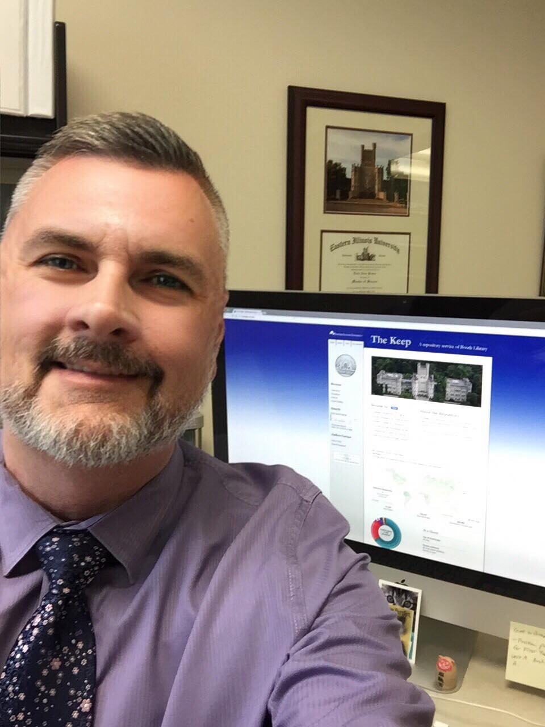
Quick and Easy Digital Thesis Uploads: For Students and Faculty Advisors
Library Services User Guide

Slide 2
Digital Depositing of Theses:
For the Student
For the Faculty Advisor

Slide 3
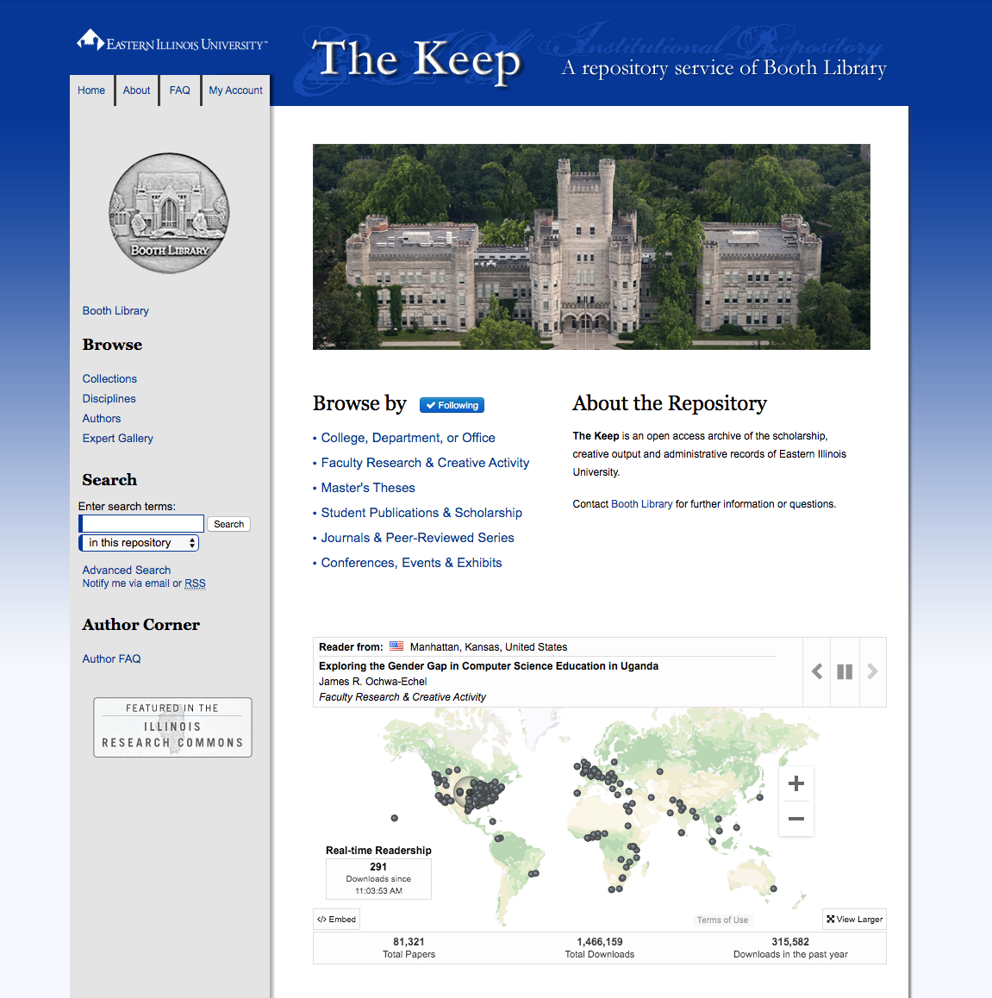
For the STUDENT:
Go to “Masters Theses” in The Keep

Slide 4
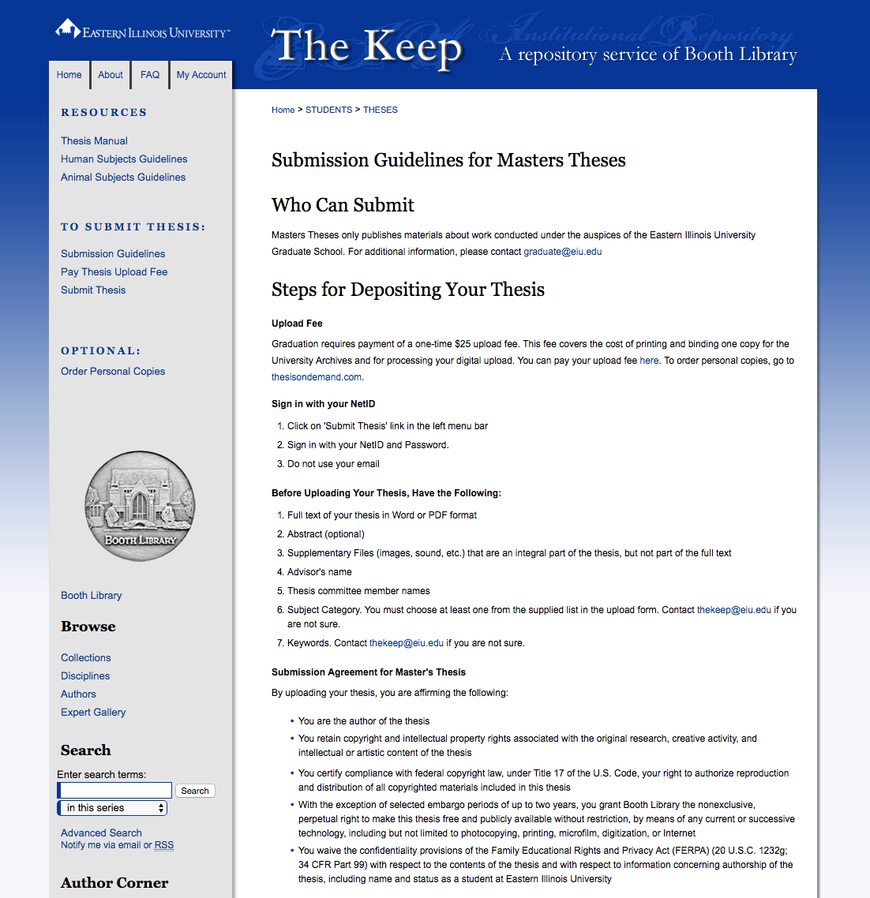
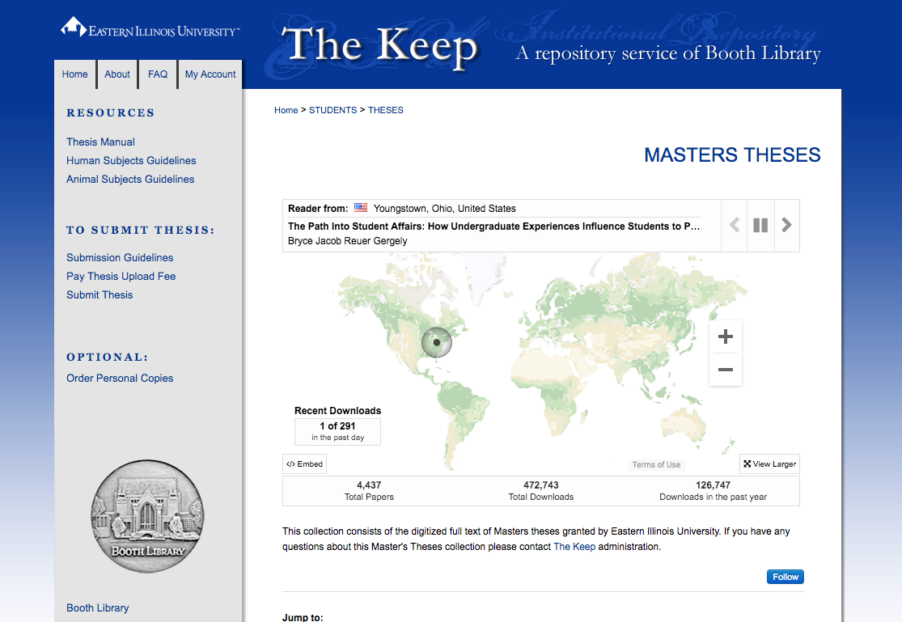
For the STUDENT:
2. Click to Review Submission Guidelines

Slide 5
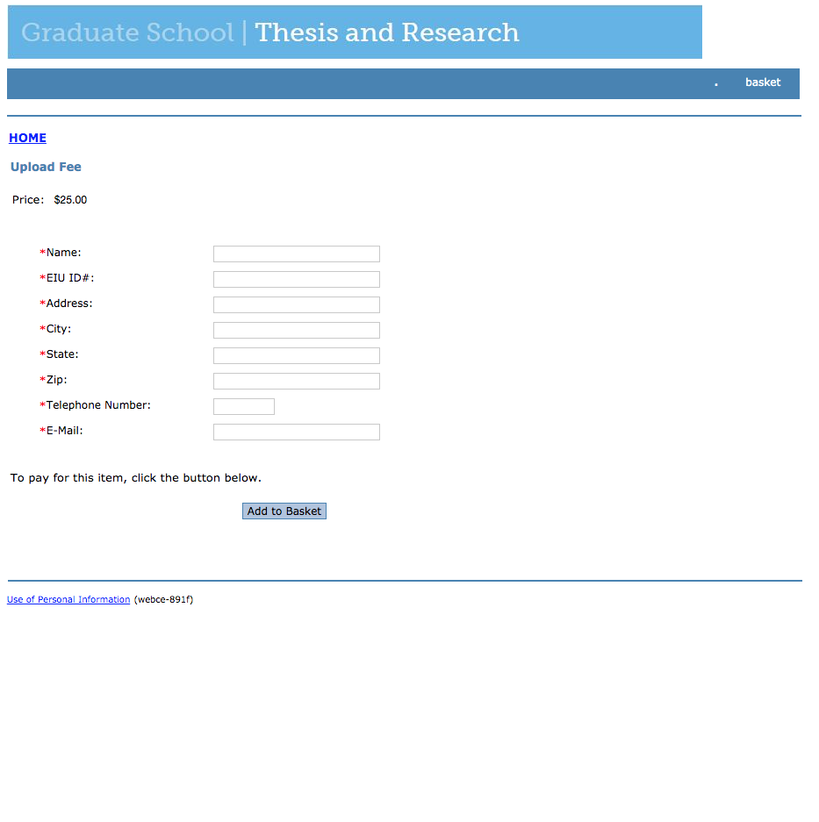
For the STUDENT:
3. Click to Pay Thesis Upload Fee (e-commerce store)

Slide 6
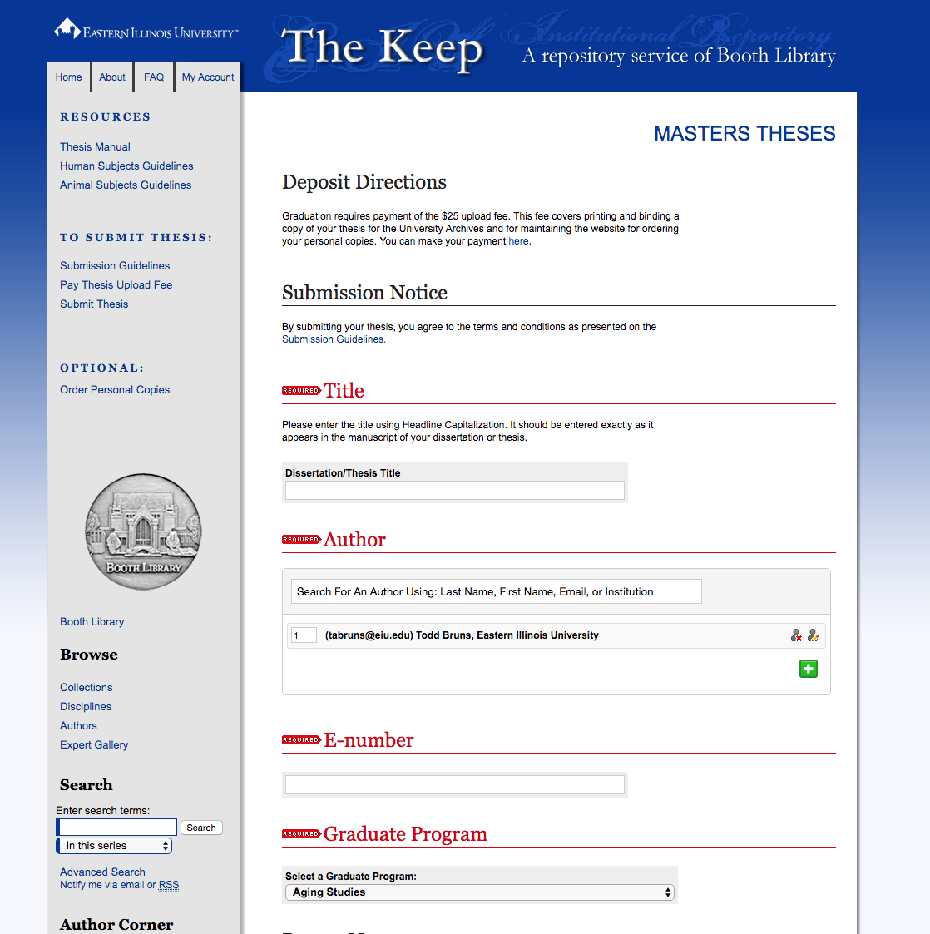
For the STUDENT:
4. Click to Submit Thesis
Fill in fields and select from drop down menus, then upload your thesis document, then submit

Slide 7
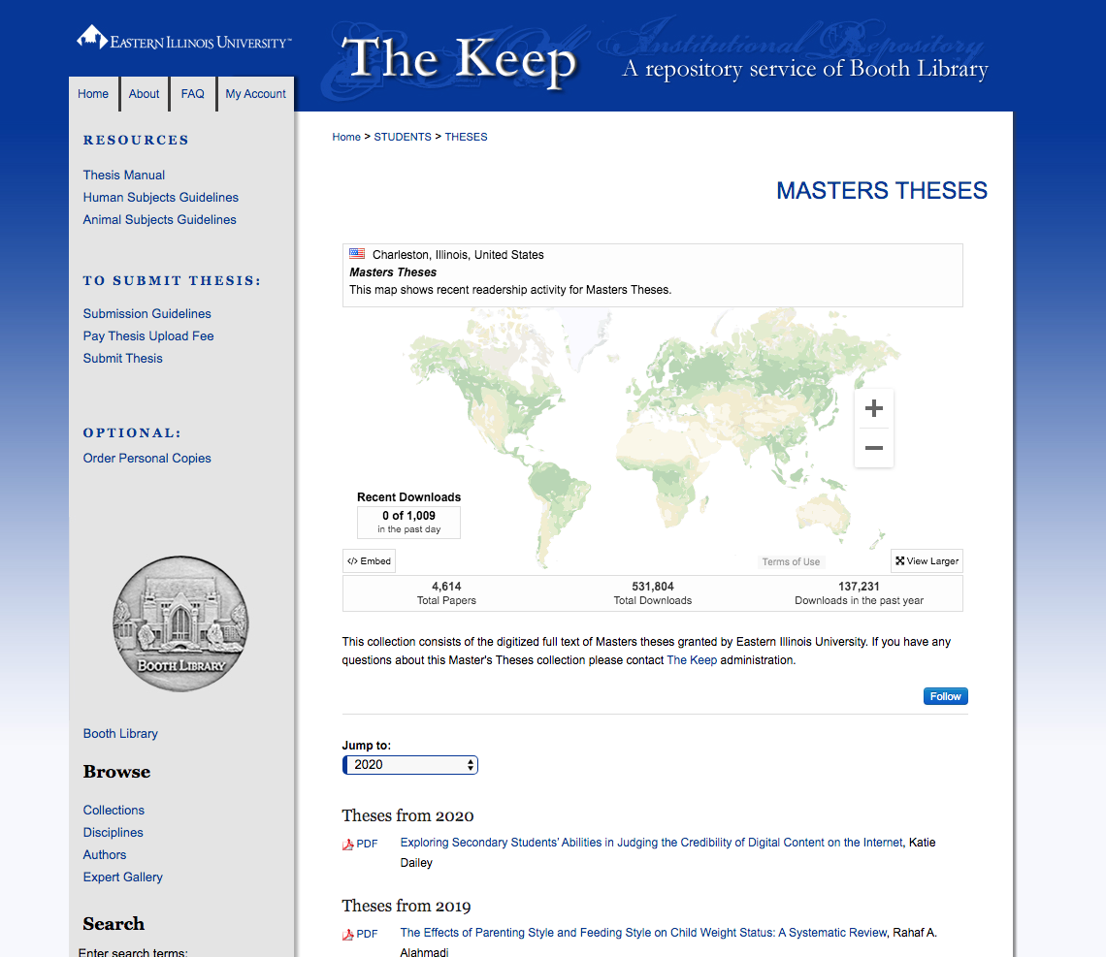
For the STUDENT:
OPTIONAL: For Personal Copies and/or Department-required print copies, order from thesisondemand.com

Slide 8
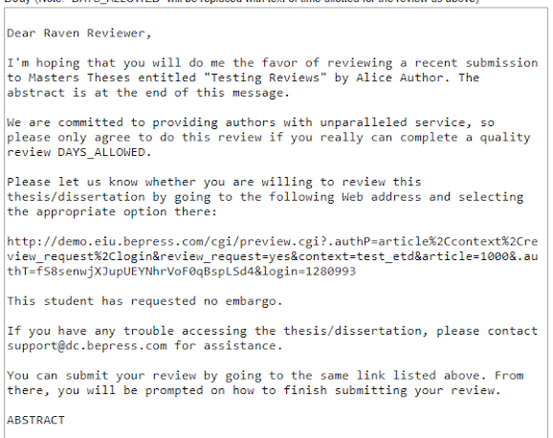
For the THESIS ADVISOR:
You will receive an email Request to Review
Note: The email includes a link for accepting the review and a statement noting the student request to embargo (none, 1 year, or 2 years)

Slide 9
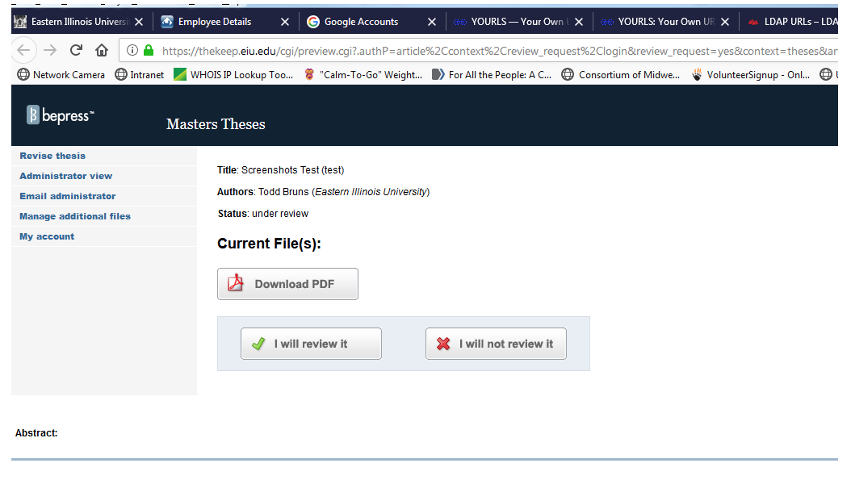
For the THESIS ADVISOR:
2. Clicking the link in the email takes you to a webpage to Accept Review
Download the PDF for review. Click the “I will review it” button.

Slide 10
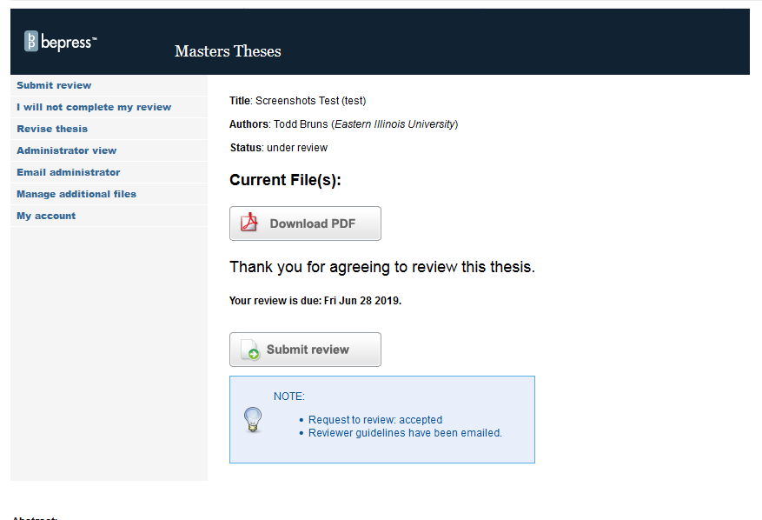
For the THESIS ADVISOR:
3. Clicking “I will review it” button takes you to a Submit Review page and also sends you an Email with a link to the Submit Review page if you want to review later.
You have 3 DAYS to review the thesis.

Slide 11
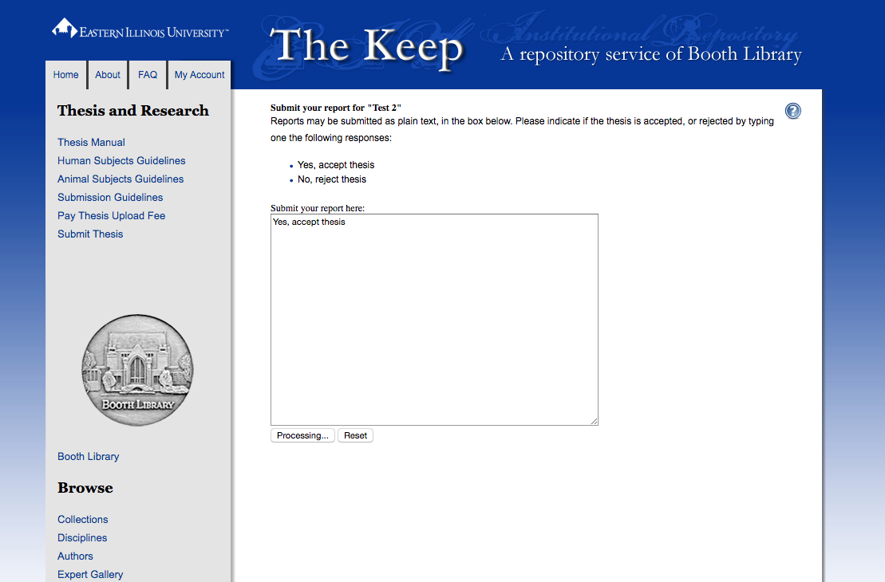
For the THESIS ADVISOR:
4. Clicking the Submit Review button takes you to the Thesis Approval page.
Type in one of the following:
Yes, Accept Thesis
Yes, Accept Thesis with 1 Year Embargo
Yes, Accept Thesis with 2 Years Embargo
No, Reject Thesis
Then click Submit.

Slide 12
Thesis is Published After:
Metadata (Thesis title, degree, etc.) information is approved by Library staff
Student has paid Upload Fee
Thesis Advisor has submitted Acceptance on Thesis Approval page

Slide 13
When the Thesis is Published:
Student receives Email notice
Thesis Advisor is CC’d Email notice automatically
Email notice is forwarded to Graduate School staff Lana Beasley and Lori Henderson, and to Graduate Coordinator of the program

Slide 14
Benefits:
Students
EASY – Pay upload fee online and upload to The Keep via easy form
LESS STRESS – no more special paper to get or running around last minute for signatures
CHEAP - $25 upload fee versus ~$60 for print depositingDirect embargo if needed
Faculty
EASY – Email notices with links
SIMPLE – Click buttons and Type in one-line Approval of Submission

Slide 15
Questions? For the Spring 2020 semester contact Ellen Corrigan or Stacey Knight-Davis at thekeep@eiu.edu

